Slide 1

FIFA 2021 Project
Linear Regression Model

Slide 2
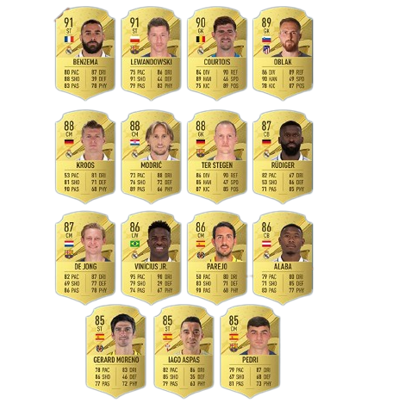

Goal
To create a model that can predict the player's overall rating (OVA) given a series of data containing players information stats.

Slide 3

Analyzing the Data
Player Information
Name
ID
Age
Height and Weight
Foot
Nationality
Club (Team and Contract)
Joined
Value
Contract Information
Position
Physical and Skill Ratings
In here we found 41 different ratings measuring players skills such as:
Attacking
Acceleration
Aggression
Reflexes
Total Stats
Base Stats
more..
Overall Ratings and Other Stats
We found two type of stats.
Attributes
W/F: Weak Foot
SM: Skill Moves
A/W: Attack Work Rate
D/W: Defense Work Rate
IR: Injury Resistance
Overall Ratings
In each position the overall rating (Example: GK 61+2)
Database size:
13700 rows x 102 columns

Slide 4
Analyzing the Data
Player Information
Name
ID
Age
Height and Weight
Foot
Nationality
Club (Team and Contract)
Joined
Value
Contract Information
Position
Physical and Skill Ratings
In here we found 41 different ratings measuring players skills such as:
Attacking
Acceleration
Aggression
Reflexes
Total Stats
Base Stats
more..
Overall Ratings and Other Stats
We found two type of stats.
Attributes
W/F: Weak Foot
SM: Skill Moves
A/W: Attack Work Rate
D/W: Defense Work Rate
IR: Injury Resistance
Overall Ratings
In each position the overall rating (Example: GK 61+2)
Database size:
13700 rows x 102 columns

Slide 5
Analyzing the Data
Player Information
Age
Height and Weight
Foot
Position
Physical and Skill Ratings
In here we found 41 different ratings measuring players skills such as:
Attacking
Acceleration
Aggression
Reflexes
more..
Overall Ratings and Other Stats
We found two type of stats.
Attributes
W/F: Weak Foot
SM: Skill Moves
A/W: Attack Work Rate
D/W: Defense Work Rate
IR: Injury Resistance
Database size:
13700 rows x 102 columns

Slide 6
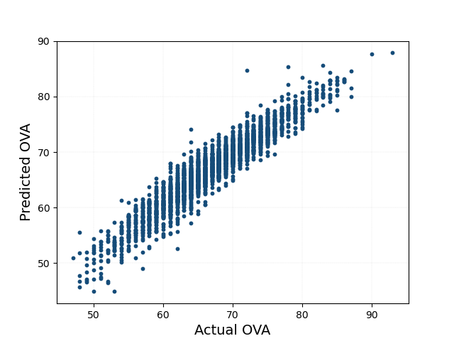
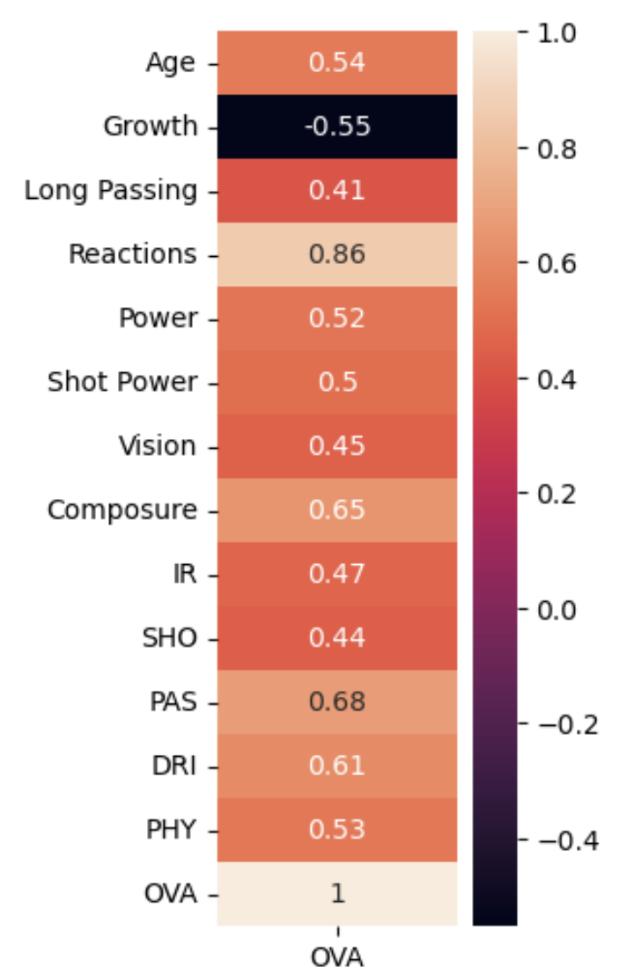
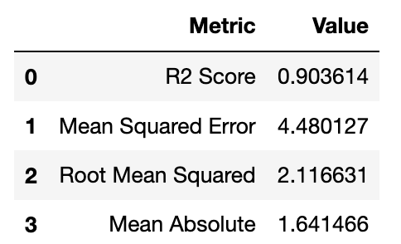
Model Results
SCATTER PLOT
CORRELATION HEATMAP

Slide 7

Conclusion

